Slide 1

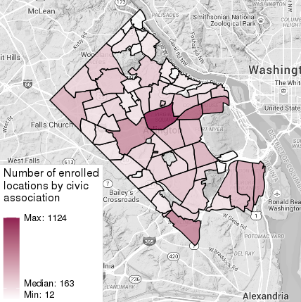
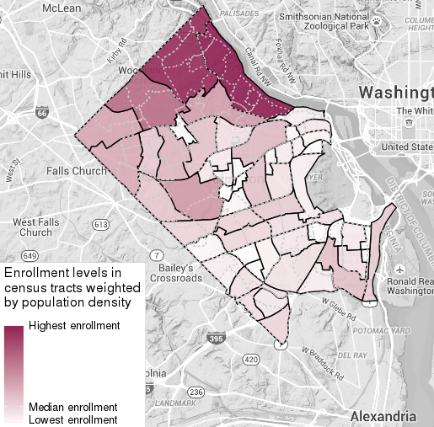
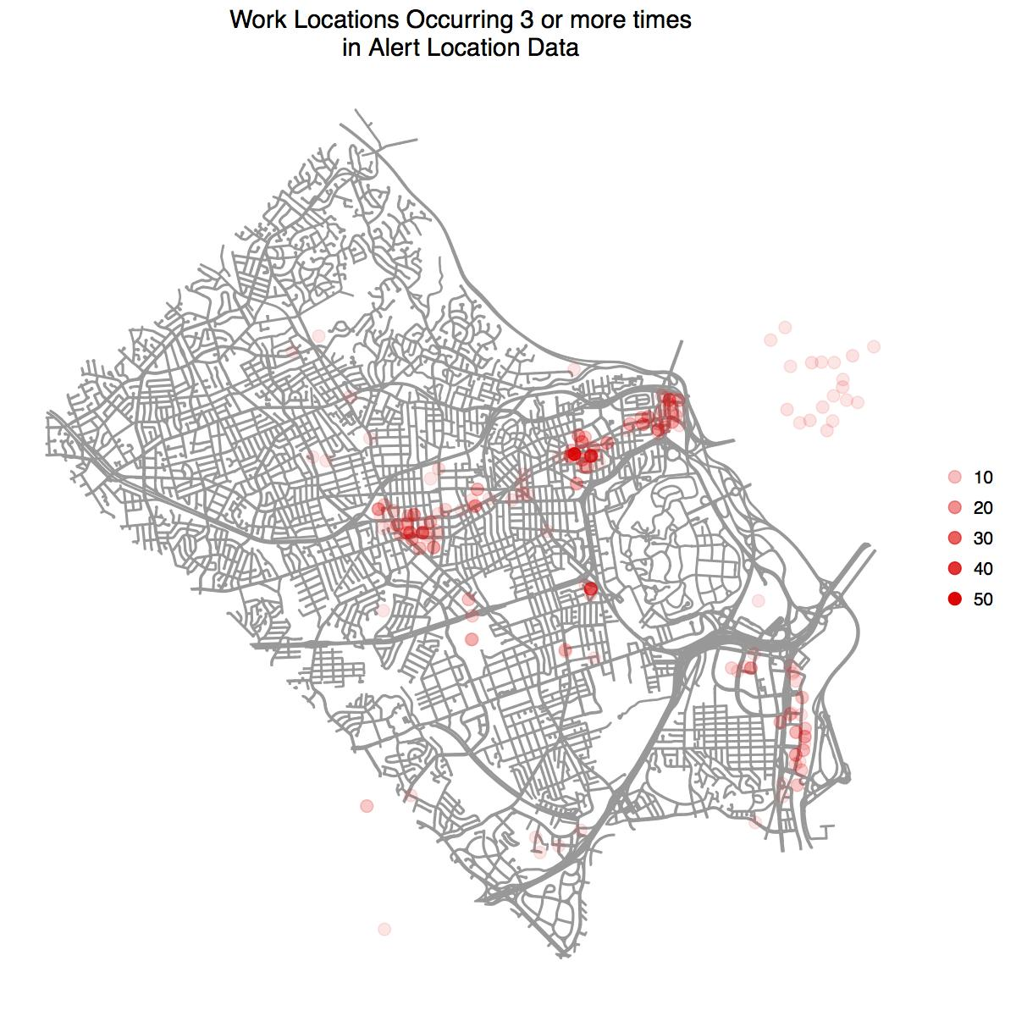
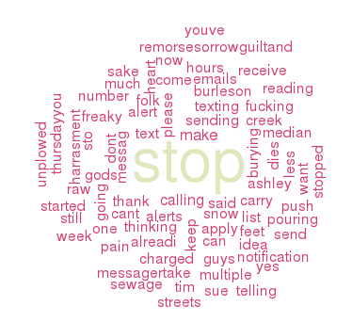
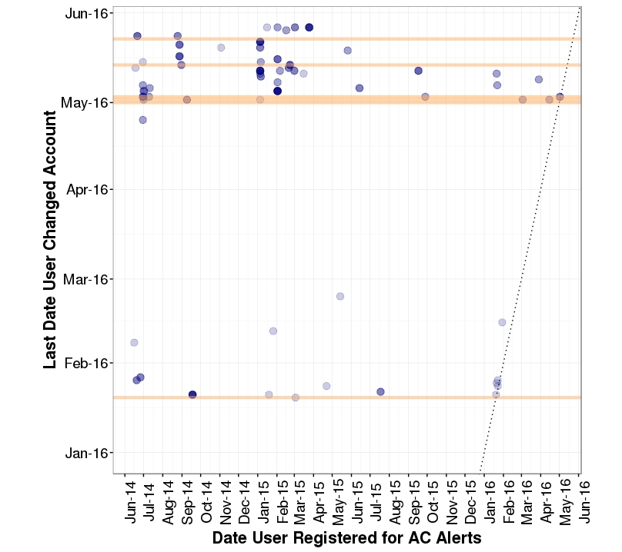
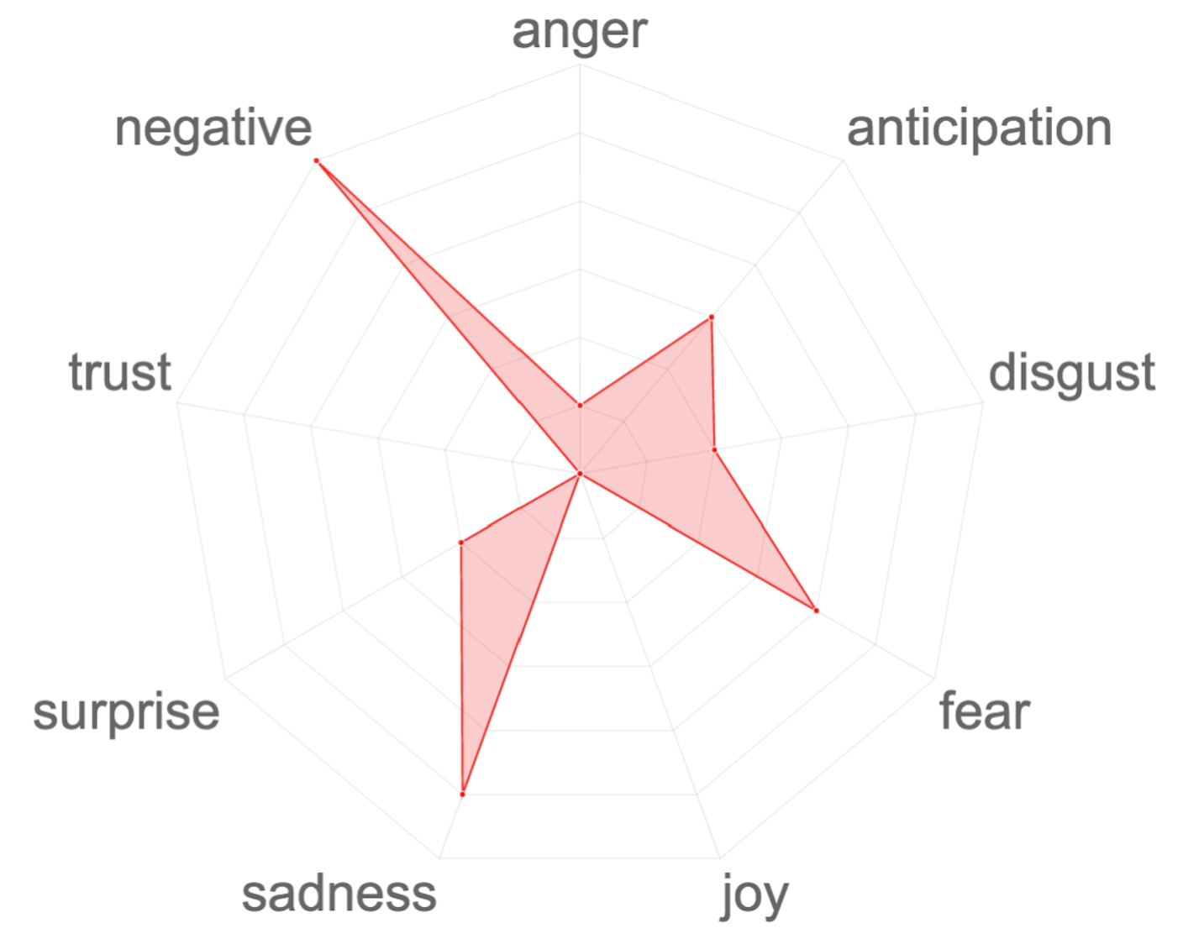
Arlington County Emergency Alerts:
Enhancing Enrollment and Effectiveness
Data Science for the Public Good
Millicent Grant (Iowa State) & Samantha Tyner (Iowa State) with Kathryn Ziemer (SDAL)
Partner: Arlington County - Will Flagler & Lauren Stienstra
Research Questions
Targeting the Right People
Who should be targeted for enrollment in Emergency Alerts?
  Who shares information?
Where are current enrollees located?
How do the alerts affect enrollee behavior?
  Is there a pattern between type or number of alerts and unsubscribing?
  What are best practices for the alert messages?
Personality traits of people who share information¹⁻³:
Openness to experience
Agreeableness
Conscientiousness
Extraversion
Trusting of others
Affiliative tendency
Public individuation
Top occupations associated with these traits:
Teachers
Instructional coordinators
Life insurance agents
Arts/Entertainment managers
Occupational therapists
School counselors
Facilities managers
Physical therapists
Where are Enrollees Located?
There is a high number of unweighted enrollment counts in the Metro Corridor, which is unsurprising because of the large population in this location (Figure 1).
When enrollment location counts are weighted by the population density of the location, North Arlington has much higher enrollment than South Arlington (Figure 2).
Subscribers can sign up to receive alerts for up to 5 different locations, such as work, home, and school. Most of the “work” enrollee locations are in the Metro Corridor (Figure 3).
Figure 1. Enrollment counts by civic associations.
Figure 2. Enrollment concentration by census tract, accounting for population density. Gray lines are civic associations, black are census tracts.
Figure 3. Enrollment counts where locations are specified by an enrollee’s “work” address.
How do Alerts Affect Behavior?
Responses to Messages
Word cloud results (Figure 4) indicate that “Stop” is the most common word enrollees use to respond to alerts.
Sentiment analysis (Figure 5) reveals that enrollees respond to text alerts with negative feelings, particularly sadness and fear.
Users modified their accounts the most after receiving 3 or more alerts in less than 90 minutes (Figure 6).
Best Practices for Alert Messaging⁴
Danger-Action Structure
Structure messages to inform recipients of the danger and the action the recipient should take
Use simple, brief, direct language
Avoid over-dramatizing
Help recipients understand the risks and where to get more information
Key Writing Principles
3 & 30 Principle: convey key information in 3 short sentences with no more than 30 words
6 & 60 Principle: write messages at a 6th grade (or lower) reading level with a 60 or more score on a readability measurement scale
Figure 4. Word cloud of the most frequent user responses to message alerts.
Figure 6. Enrollees’ last modification of their account. Orange lines indicate major events where the system sent out many alerts. In January 2016 there was a major blizzard and in May 2016 there were several days with severe thunderstorms.
Figure 5. Sentiment analysis of responses to messages.
Note. The darker the circle, the higher the number of people who modified their account.
References
Matzler, K., Renzl, B., Mooradian, T., von Krogh, G., & Mueller, J. (2011). Personality traits, affective commitment, documentation of knowledge, and knowledge sharing. The International Journal of Human Resource Management, 22, 296-310.
Mooradian, T., Renzl, B., & Matzler, K. (2006). Who trusts? Personality, trust and knowledge sharing. Management Learning, 37, 523-540.
Lee, E., & Jang, J. (2010). Profiling good Samaritans in online knowledge forums: Effects of affiliative tendency, self-esteem, and public individuation on knowledge sharing. Computers in Human Behavior, 26, 1336-1344.
Chandler, R. (2010). Emergency Notification. Santa Barbara, CA: Praeger.
bi.vt.edu/sdal

